Slide 1
Optimized multi-dimensional event storage with space filling curves
Dan Nixon (STFC, UK)
Owen Arnold (Tessella, UK)
Simon Heybrock (ESS, Sweden)
Notes:
Introduce myself
Project timescale and groups

Slide 2
Background
Datasets with multiple dimensions
Neutron scattering often gives sparse data
Solution: MDEventWorkspace
Store processed neutron events
Events have N coordinates, signal, error and metadata
Notes:
Reduced datasets may have many dimensions
Momentum transfer
Energy transfer
Log/scan values
Often a sparse distribution due to scattering properties of sample
More memory efficient to store neutron events rather than histogram data
MDEventWorksapce
Store processed multi-dimensional data
Events contain:
Coordinate (with N dimensions)
Signal
Error
(Optional) metadata

Slide 3
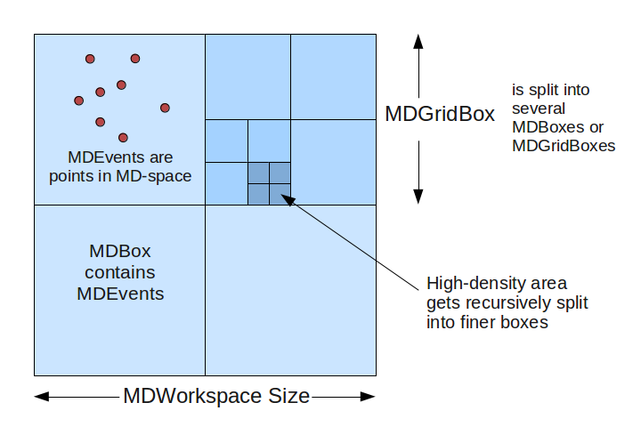
Existing Mantid implementation
MDEventWorkspace
MDGridBox
MDGirdBox
…
MDGridBox
…
MDGridBox
MDBox
MDEvent
…
MDBox
MDEvent
MDEvent
...
…
…
Notes:
MD events stored in a hierarchal “box structure”
MDEventWorkspace contains MDGridBoxes and MDBoxes
MDGridBoxes contain other MDGridBoxes and MDBoxes
MDBoxes contain MDEvents
Each box stores it’s MD events in a vector
Structure is created such that events are event distributed over (leaf) boxes
Distributed via recursive splitting
Split a box if it’s event count is above a threshold
Stop splitting at a given tree depth

Slide 4
Issues
Creation
Events being moved between event lists during box splitting phase
Multiple memory allocations
Merging
Inefficiently adding single events to new workspace
Notes:
Workspace creation takes a significant amount of time
Multiple allocations
Events being moved as splitting occurs
MD box owns it’s child events
Merging multiple workspaces takes a significant amount of time
Create a new workspace by adding events for each workspace to merge into a new workspace

Slide 5
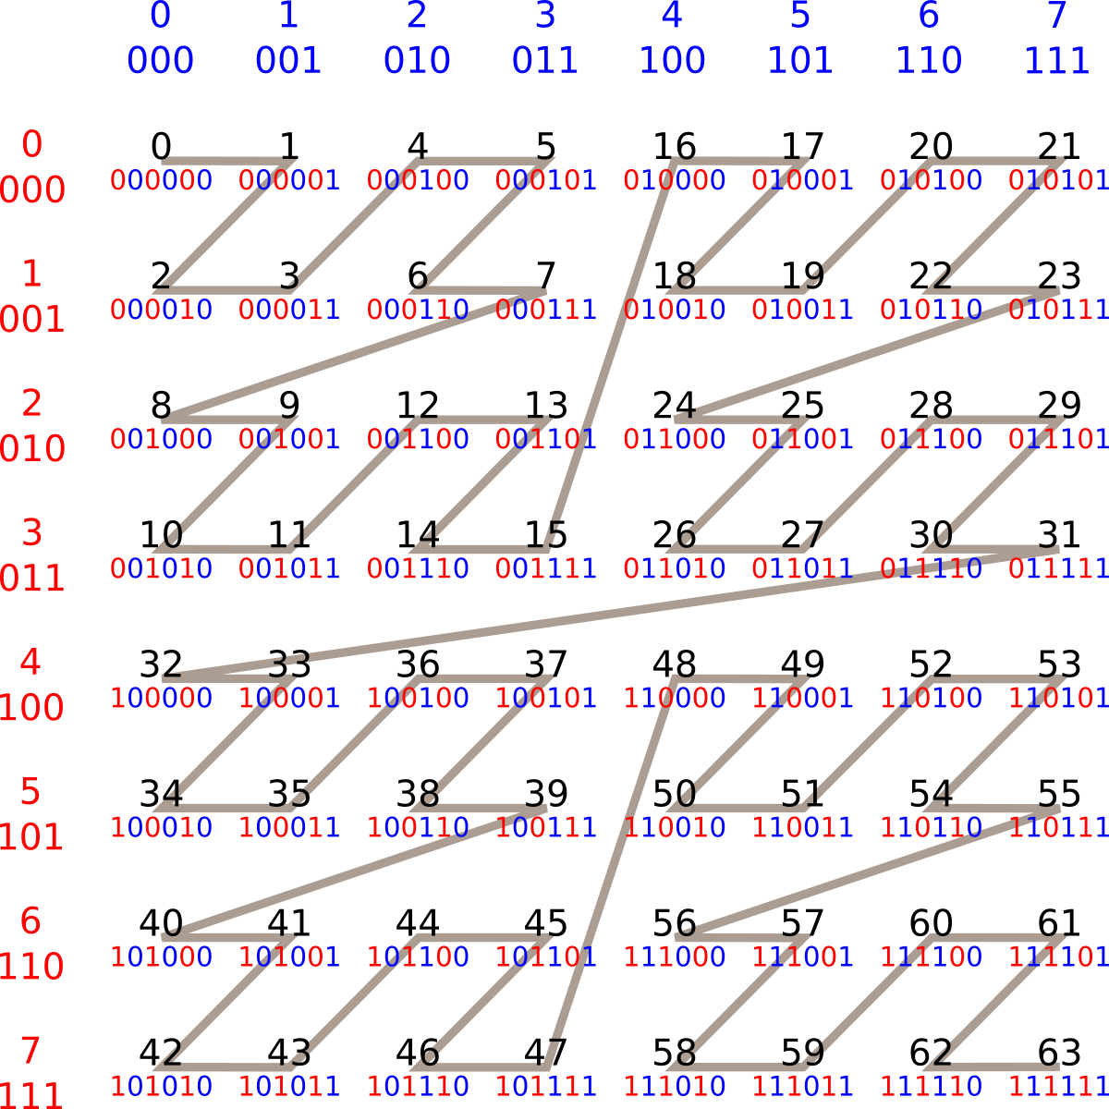
Z-order space filling curve
Store data in contiguous block of memory
Coordinates encoded in Morton numbers
Simple creation procedure
Notes:
Stores all data in a contiguous block of memory
Encodes spatial data as Morton numbers
Assuming integer coordinates
Interleave integer coordinates for each axis
This gives the Morton number
Sort by Morton number
This gives the data in Z-curve order
Process for creating a curve is very simple
Integer interleaving and sort
Additional points:
A point on the curve can have any number of pieces of data (events in Mantid’s case) associated with it
Order of data when Morton numbers are equal is irrelevant
So sorting does not have to be stable

Slide 6
Coordinate representation
Floating point MD space must be mapped to integer Morton “grid”
Tradeoff between memory consumption/speed and precision
For 4D:
64bit Morton number, 16bit integer, 65535 unique values per dimension
128 bit Morton number, 32bit integer, 4294967295 unique values per dimension
Notes:
To represent floating point coordinates, a mapping between floating point and integers must be used
Transformation performs very fine binning
Lower precision uses less memory and is faster
Higher precision uses more memory and is slower
For 3 and 4 dimensions, most cases are likely to be satisfied by a 64 or 128 bit Morton number

Slide 7
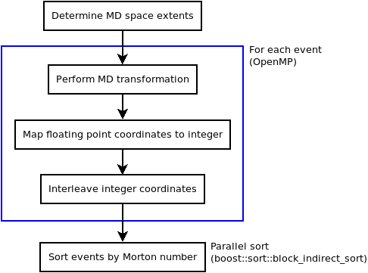
Curve creation
Notes:
Dataset creation is a two stage process:
Create the Z order curve
Create the box structure
Creating the curve:
Determine extents of MD space
This should be as large as foreseeably required
Expanding it is expensive
Select Morton number width/precision
Calculate the Morton number position of each event:
This determines where the event appears on the Z-order curve (reference diagram on previous slide)
Perform conversion to MD space as normal
This gives floating point coordinates
Map floating point coordinates onto intermediate integers
Interleave intermediate integers to give Morton number
Per event operations are performed in parallel via OpenMP
All events added to a single “event list” after being created
Sort event list by Morton number
Several sort algorithms benchmarked
boost::sort::block_indirect_sort was best suited
Made good use of parallelism
Low memory overhead

Slide 8
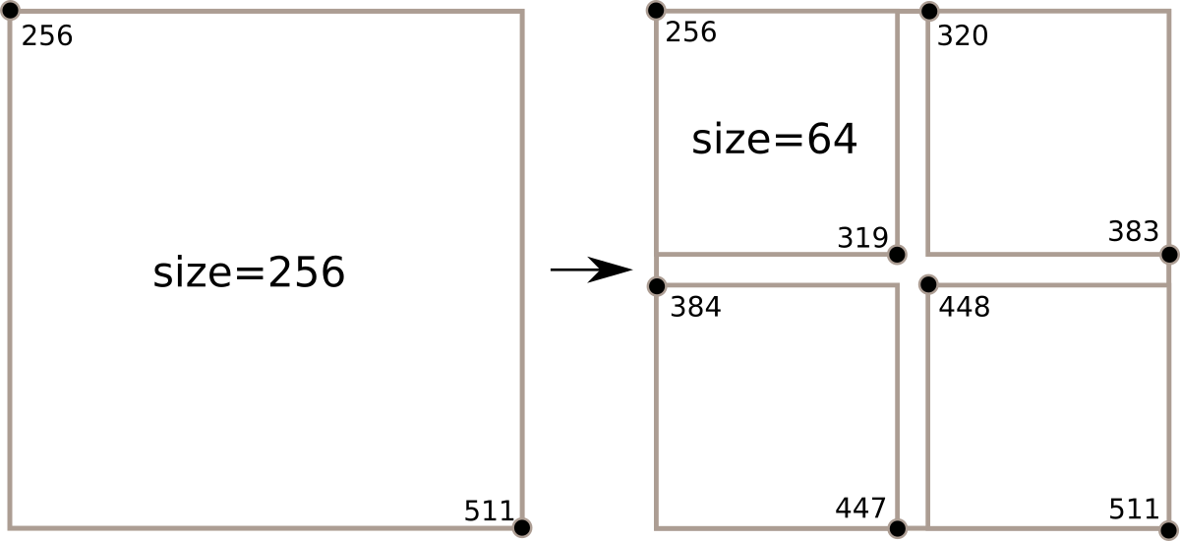
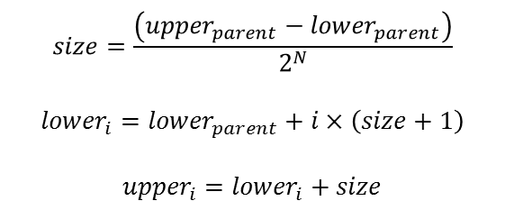
Box structure creation
Recursive splitting approach
Functionally similar to existing Mantid implementation
No reallocation/moving of events
Boxes store iterators to curve
Fast box splitting
$$size=\frac{\left({upper}_{parent}−{lower}_{parent}\right)}{2^{N}}$$
$${lower}_{i}={lower}_{parent}+i×\left(size+1\right)$$
$${upper}_{i}={lower}_{i}+size$$
Notes:
Create a box structure similar to existing Mantid implementation
Boxes store iterators to the events in the Z-order curve
Iterators to start and end of range of events that fall within the box
No moving/reallocation of events needed
Fixed to splitting each box by half in each axis
2^{N} child boxes for every split
Box bounds checking is a single integer comparison

Slide 9
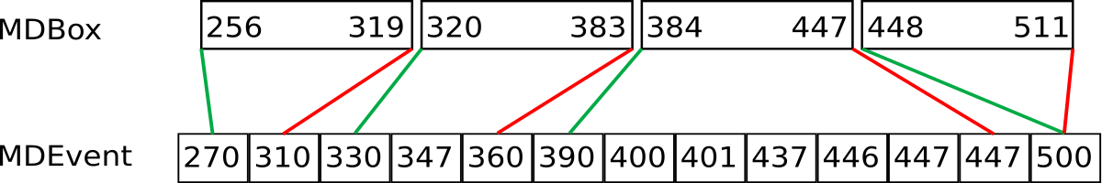
Box structure creation
Create “root” box
Recursively split boxes (OpenMP):
Calculate Morton bounds of child boxes
Fill boxes
Continue recursive splitting in child boxes
Notes:
Create root box that contains all events
Recursive splitting:
Check exit conditions
Too few events in box
Maximum tree depth reached
Calculate Morton number boundaries of child boxes
Divide Morton number box bounds into 2^{N} equal ranges
Iterate over events in box to find being and end iterators for each child box
Create new child boxes and continue recursion
Box splitting performed in parallel using OpenMP tasks

Slide 10
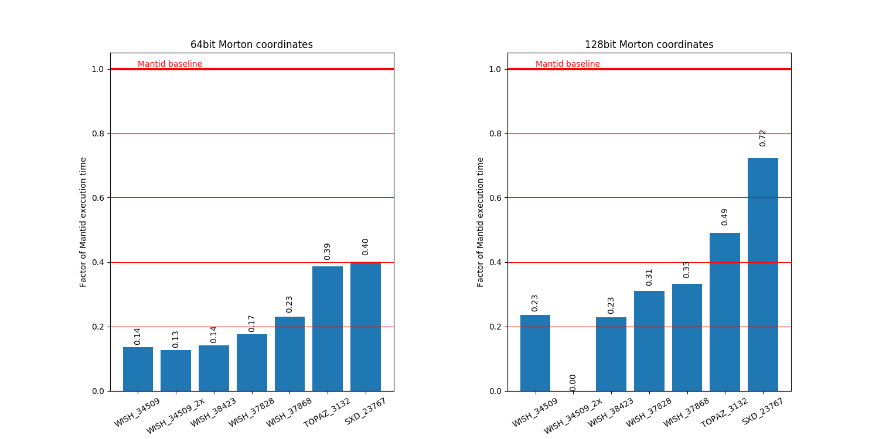
Creation performance
470 940 15 21 7 9 14
470 940 15 21 7 9 14
Notes:
Graphs show execution times as a factor of Mantid execution time for the same dataset
Tested with several datasets with different distributions and event counts
Event counts (from left to right):
~470M
~940M
~15M
~21M
~7M
~9M
~14M
Larger WISH dataset could not fit in memory of test system with 128bit Morton number

Slide 11
Coordinate retrieval
Obtain original floating point coordinates
Partial reversal of creation process:
Deinterleave Morton number
Scale integer coordinates to floating point range
Performance (linear read)
Mantid is a direct lookup
64bit: 95M events/second
128bit: 22M events/second
Notes:
Access original floating point coordinates
Requires reversing coordinate transforms done as part of creation process
Deinterleave Morton number
Transform integers back to floating point range
Event rate performance
Performance tested for linear/sequential reads
No direct comparison with Mantid
Mantid is a direct lookup as floating point coordinates are stored with MD events in Mantid

Slide 12
Binning
Follows similar implementation to Mantid’s BinMD
Create a transformation that maps floating point MD coordinates to bin index on each axis
To handle Morton number coordinates:
Deinterleave to obtain integer coordinates
Create a transformation to map integer coordinates to bin index
Notes:
Majority of implementation is identical to Mantid’s BinMD
Uses a transformation to map floating point coordinates onto integer bin indices
To adapt to Morton number coordinates
Deinterleave
Modify transformation to transform from intermediate integers to bin index

Slide 13
Binning
Performance (bare minimum benchmark)
Mantid: 319M events/second
64bit: 301M events/second
128bit: 127M events/second
64bit: ~0.94 event rate of Mantid
128bit: ~0.54 event rate of Mantid
Notes:
Benchmark only considers parts of implementation that differs
Generation and applying coordinate transformation

Slide 14
Merging
Merge/append events from one workspace to another
Useful for combining datasets from each step of a scan
Possible with workspaces with identical MD extents
Merge event curves
Merge operation of merge sort
Recreate box structure
Notes:
Combining datasets from scans
Efficient merging of event curves possible when created with the same MD extents
Morton number coordinates are comparable
Can merge (already sorted) event curves using the merge step of merge sort
Box structure must be recreated from new (merged) event curve
No simple way to reuse the existing box structures

Slide 15
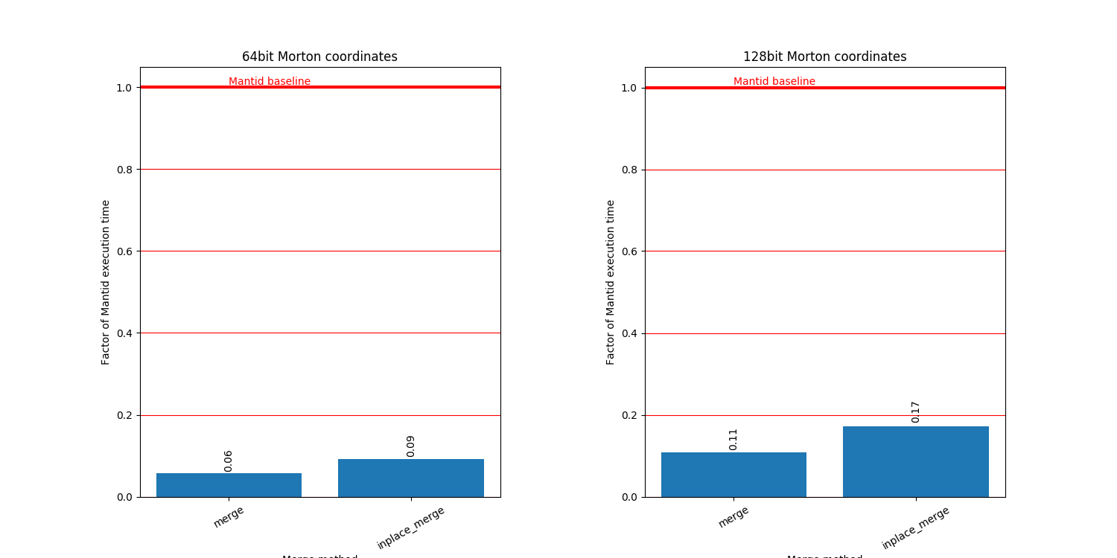
Merging performance
Notes:
Tested merging two steps of an angular scan on SXD
Tested std::merge and std::inplace_merge
std::merge requires allocating all events again and gives the best performance when this is possible
std::inplace_merge extends the first event curve and performs the merge in-place, when the first curve cannot be extended this results in additional event copy operations

Slide 16
Summary
Benefits
Fast creation
Fast merging
Simple implementation
Limitations
Slower integration/binning
Slower coordinate access
Precision (float/integer mapping)
Notes:
Performance gains of creation and merging outweigh performance degradation in binning and coordinate access
Loss of precision can be mitigated

Slide 17
Questions?

Slide 18
Future
Prototype implemented and all performance areas considered/benchmarked
ESS is looking into cost of implementing within Mantid

